Slide 1
DSML for OpenSees
Ali I. Ozdagli

Slide 2
What is OpenSees
Open System for Earthquake Engineering Simulation
Modeling and analyzing the nonlinear response of systems
Simulation of the seismic response of structural and geotechnical systems
Used for educational and academic purposes
Can be downloaded from: http://opensees.berkeley.edu/index.php

Slide 3
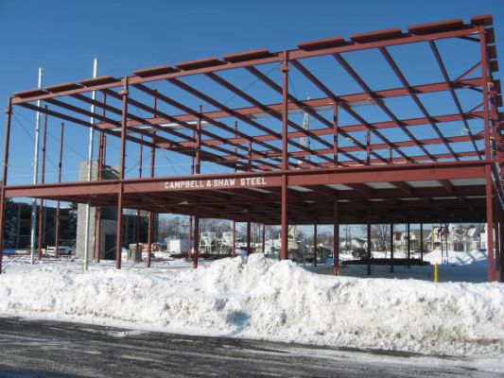
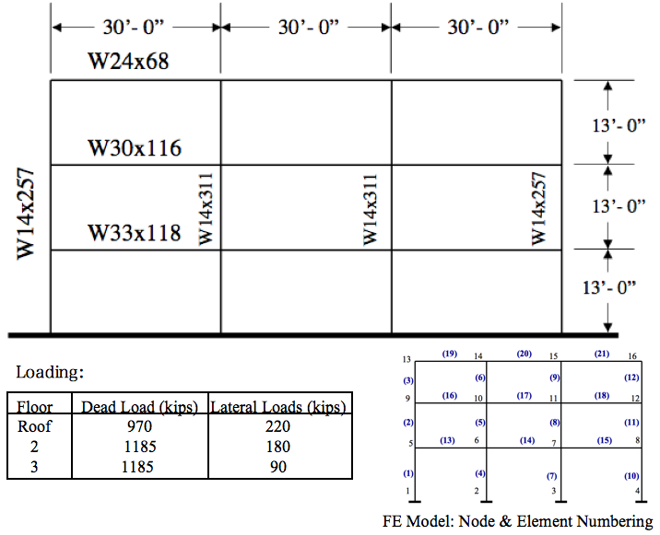
Idealization of Structures
Node
Element
http://img.archiexpo.com/images_ae/photo-g/89366-7437929.jpg
http://opensees.berkeley.edu/wiki/index.php/Elastic_Frame_Example

Slide 4
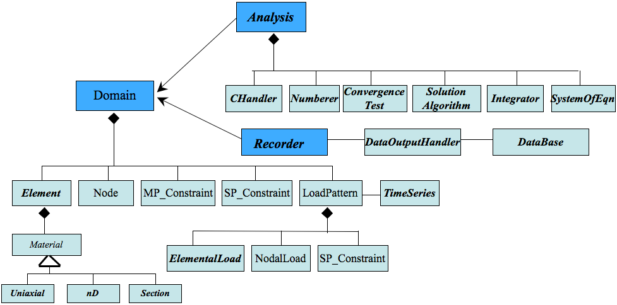
OpenSees Abstraction
Structure
Model
Nodes
Element
Analysis
Problem formation
Solver
Recorder
Saving file
Structure
Model

Slide 5
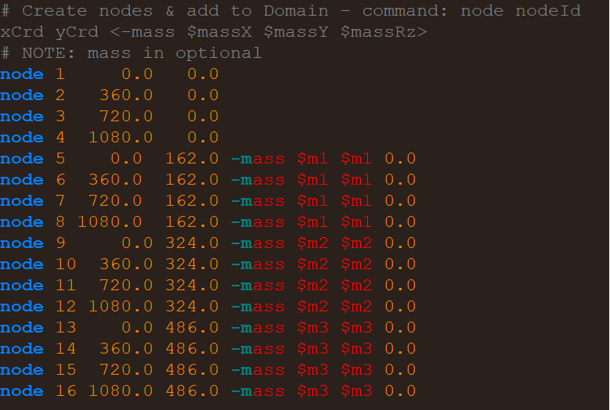
Coding For OpenSees
Uses Tcl for interpreting input
Basic control structures
File manipulation
Sourcing other files
Typical interaction:
Run OpenSees from terminal and type source input.tcl
Enter each line from your input line by line
OpenSees input.tcl

Slide 6
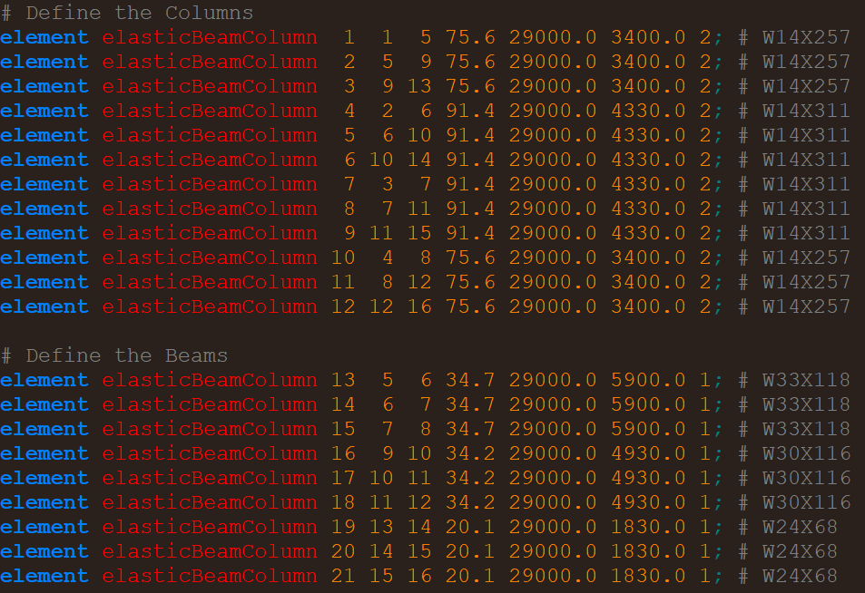
Further into OpenSees Coding Modeling domain
Node
Element
http://img.archiexpo.com/images_ae/photo-g/89366-7437929.jpg
http://opensees.berkeley.edu/wiki/index.php/Elastic_Frame_Example

Slide 7
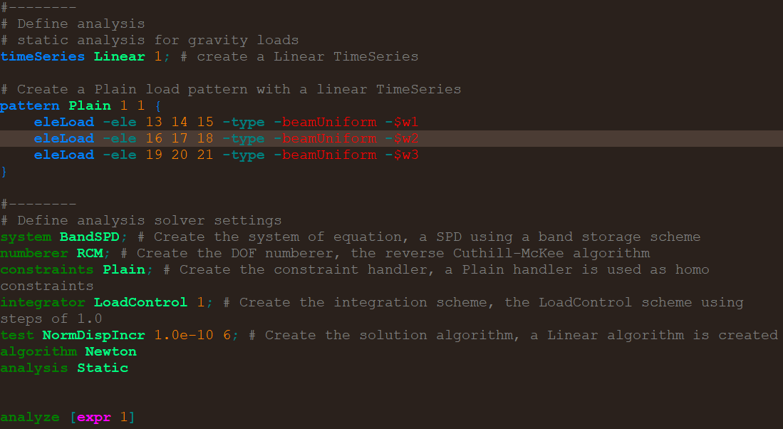
Further into OpenSees Coding Analysis domain
Loading patterns
Solver settings
Simulation Initiations
http://img.archiexpo.com/images_ae/photo-g/89366-7437929.jpg
http://opensees.berkeley.edu/wiki/index.php/Elastic_Frame_Example

Slide 8
Further into OpenSees Coding Recorder domain
Force Response at specific elements
Displacement response of specific nodes @ horizontal direction
http://img.archiexpo.com/images_ae/photo-g/89366-7437929.jpg
http://opensees.berkeley.edu/wiki/index.php/Elastic_Frame_Example

Slide 9
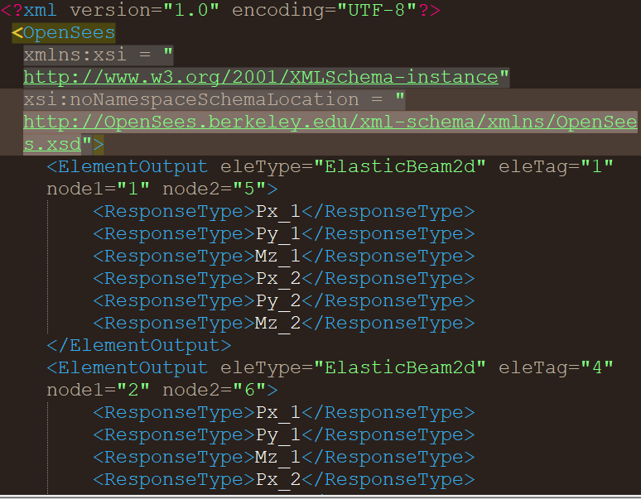
Obtaining Results
Supports: Plain, XML, Binary, TCP/IP
Node reactions (disp, vel, accel)
Element reactions (forces, strains)
Dynamic characteristics (period, damping)

Slide 10
WebGME Implementation
Model Structure
Model
Nodes
Elements
Analysis
Loading Pattern
Static or Transient
Loading Type
Tolerance Test
Solver
Recorders

Slide 11
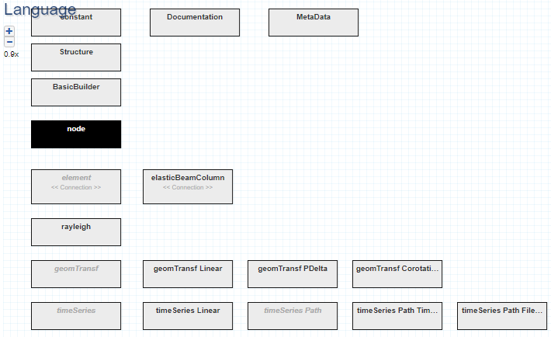
MetaModeling

Slide 12
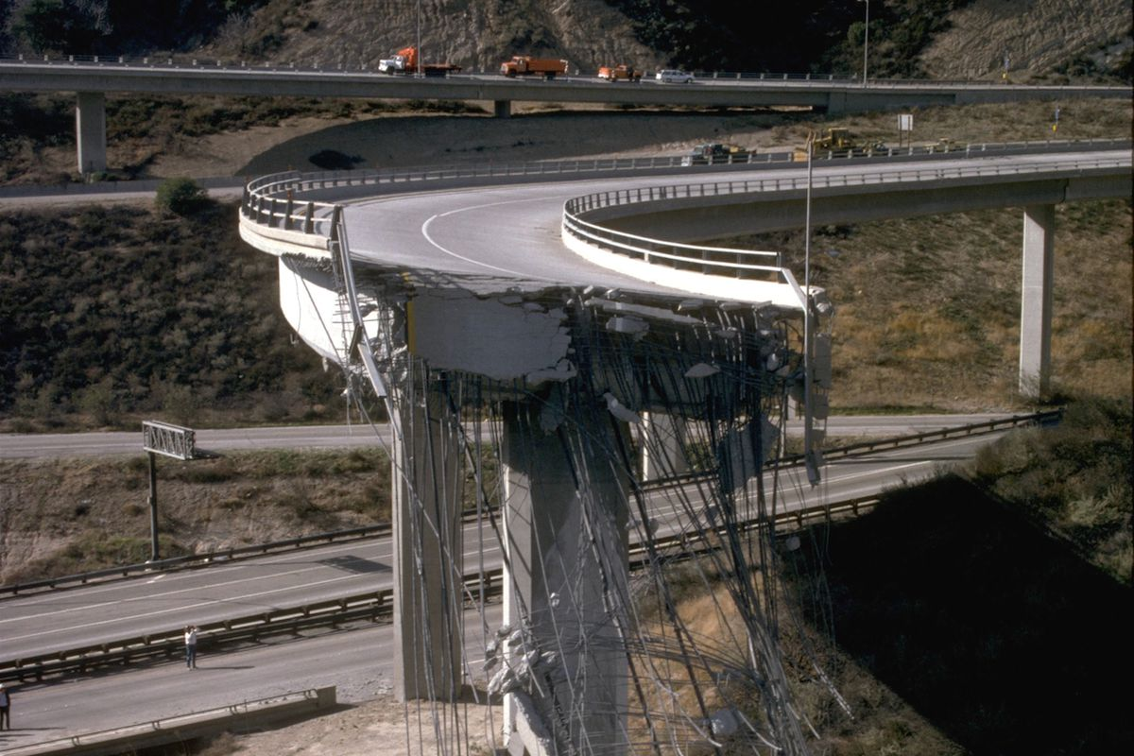
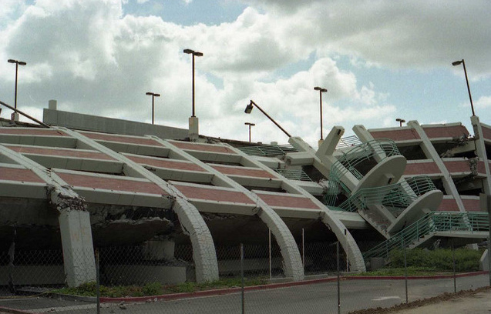
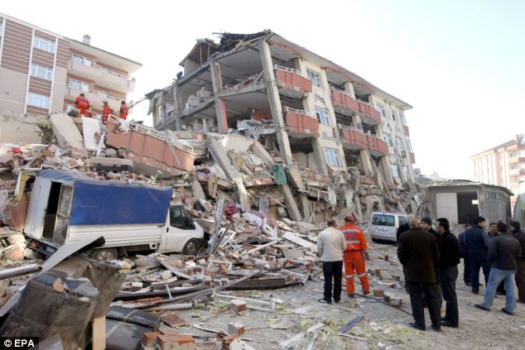
Any Questions

Slide 13
Node
Element
Boundary Condition

